Slide 1
Wireless Data Logger for Elevator Trac
TERM PROJECT
Arash Ashrafnejad
Redion Xhepa

Slide 2
Long range wireless transmission and logging embedded system for monitoring elevator traffic.
Intro
Sample height data from high-
precision atmospheric sensor together with accurate real time data
Future use:Reduce the elevator traffic and save energy and time(using machine learning algorithms).

Slide 3
1)HC-12 long-range transceiver x2 2)433 MHz Wireless Radio Antenna x2 3)DS3231 Precision RTC Memory Module 4)Micro SD card SPI card reader module 5)Floor displaying device(7-segment display) 6)Kits need for making a portable device(adapters,external power supply etc)
Components used

Slide 4
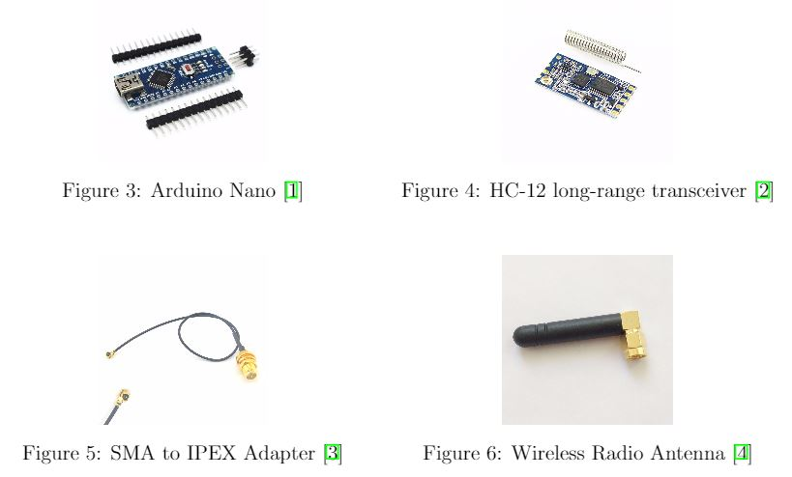
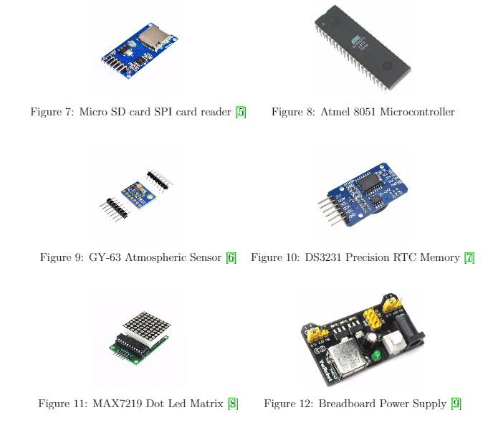
Equipments

Slide 5
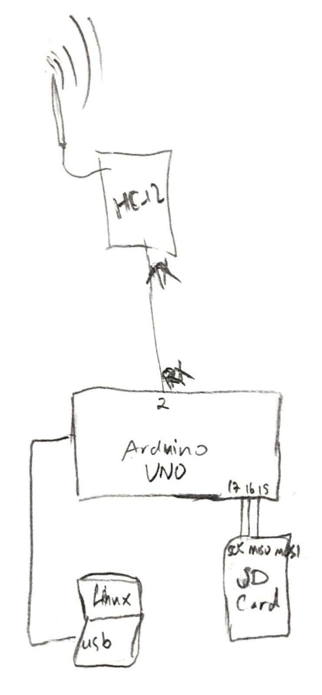
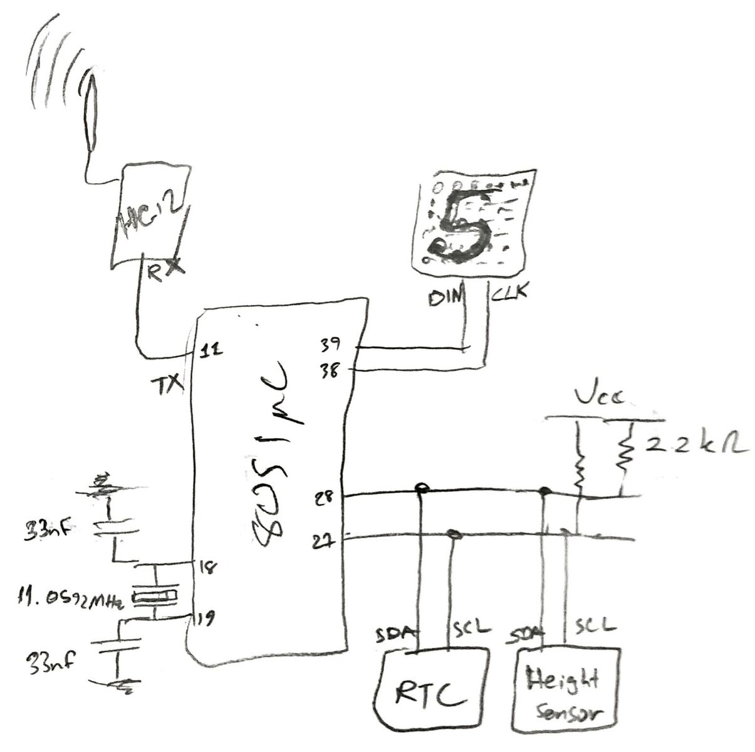
Schematics

Slide 6
Difficulties
Seting up the circuit(several equipments had to be tested with arduino programing)
Sampling of Atmospheric sensor, RTC Module
Synthesizing a reliable algorithm
Datasheets that were incomplete
Too many lines of codes which needed debugg
Trial and error diagnostication of the correctness of our module(at least 100 times)

Slide 7
We tried to help one-another as much as possible
Arash Ashrafnejad
Principal proposer of the project
Has done 60% of the workload(circuit set up+code)
Debugged the code of Redion and tested in Arduino
Division of work
Redion Xhepa
Wrote 60% of the Assembly code(the rest was debugged and added by Arash)
Trial and error checking of the correctness of the code
Proposed some solutions to the encountered problems

Slide 8
Thank you !
Hope you liked our idea !

